Slide 1




NEXT GEN EMPLOYABILITY PROGRAM
Creating a future-ready workforce
Team Members
College Name
Student Name :MUKESH C
Student ID :511321104057
KINGSTON ENGINEERING COLLEGE(5113)

Slide 2

CAPSTONE PROJECT SHOWCASE
Project Title
Building Bus Reservation System using Python and Django
Abstract | Problem Statement | Project Overview | Proposed Solution | Technology Used | Modelling & Results | Conclusion

Slide 3
Abstract
Embark on a journey of convenience and efficiency with our Bus Reservation System, designed to streamline the booking process and enhance the travel experience. Our platform revolutionizes the way travelers plan and book their bus journeys, offering a comprehensive solution that caters to their needs. With a user-friendly interface and intuitive features, users can effortlessly search for buses, compare options, and secure their seats with ease. Whether commuting for work or embarking on a leisurely adventure, our system ensures a seamless booking experience from start to finish.
At the heart of our Bus Reservation System is a commitment to providing travelers with access to a wide range of routes, schedules, and amenities, empowering them to make informed decisions and travel confidently. From city-hopping to long-distance travel, our platform caters to diverse preferences and requirements, offering flexibility and convenience at every step.
With robust security measures in place, users can book their tickets with peace of mind, knowing that their personal information is protected. Our system also provides real-time updates and notifications, keeping travelers informed about their bookings and any changes to their itinerary.
Join us on a journey of exploration and discovery, where booking a bus ticket is as simple as a few clicks. Experience the future of bus travel with our Bus Reservation System, where convenience, efficiency, and reliability converge to redefine the way you travel.
Source :

Slide 4
Problem Statement
The problem statement for the bus reservation system project revolves around addressing the inefficiencies and complexities associated with traditional bus booking processes. In today's fast-paced world, passengers encounter numerous challenges, including long queues, manual ticketing systems, and limited accessibility to bus schedules and availability. This project aims to streamline and modernize the bus reservation process by developing a user-friendly online platform.
Key issues to be tackled include improving accessibility to bus routes and schedules, simplifying the booking process, enhancing user experience, and ensuring secure payment transactions. Additionally, the system will prioritize scalability and adaptability to accommodate future expansion and technological advancements.
By implementing this solution, passengers will benefit from a convenient and efficient booking experience, allowing them to easily browse available routes, select preferred travel dates, choose seats, and make secure payments online. Moreover, the system will provide real-time updates on bus availability, departure times, and travel notifications, enhancing overall customer satisfaction and experience.
Ultimately, the goal is to revolutionize the bus reservation industry by harnessing the power of technology to create a seamless and user-centric booking platform that meets the needs of modern travelers.
Source :

Slide 5
Project Overview
The project aims to develop a comprehensive bus reservation system to modernize and streamline the process of booking bus tickets. It seeks to address the challenges faced by passengers in traditional booking methods, such as long queues, manual ticketing systems, and limited accessibility to bus schedules and availability.
The system will provide a user-friendly online platform accessible through web and mobile devices. It will offer features such as browsing available routes, selecting travel dates, choosing seats, and making secure online payments. Additionally, passengers will receive real-time updates on bus availability, departure times, and travel notifications, enhancing their overall booking experience.
Key components of the system include a robust backend database to manage bus routes, schedules, and bookings, as well as a responsive frontend interface for users to interact with. The system will prioritize scalability and adaptability to accommodate future expansion and technological advancements.
Furthermore, the project will focus on ensuring the security and reliability of payment transactions, adhering to industry standards and best practices. It will also include features to handle cancellations and refunds, as well as provide customer support services.
Overall, the bus reservation system aims to revolutionize the industry by leveraging technology to create a seamless and efficient booking platform that meets the needs of modern travelers.
Source :

Slide 6
Proposed Solution
.
The proposed solution encompasses the development of a sophisticated bus reservation system designed to revolutionize the way passengers book and manage their bus travel. This comprehensive platform aims to address the shortcomings of traditional booking methods while offering a seamless and user-friendly experience to travelers.
Key Features:
User-Friendly Interface:
The system will feature an intuitive and user-friendly interface accessible through both web and mobile devices. Users will be able to easily navigate through the platform to search for available routes, select travel dates, choose seats, and make secure online payments. The interface will prioritize simplicity and efficiency, ensuring a hassle-free booking experience for passengers of all ages and technical backgrounds.
buses or last-minute cancellations.
Comprehensive Route Management:
The system will include a robust backend database to manage bus routes, schedules, and bookings. Administrators will have the ability to update and modify route information as needed, ensuring accuracy and reliability for users. Additionally, the system will support dynamic pricing models based on factors such as demand, time of booking, and seat availability.
Source : Brown, M. (2018). "Designing User-Centric Travel Applications." O'Reilly Media.

Slide 7
Secure Payment Processing:
To ensure the security of online transactions, the system will integrate with reputable payment gateways and adhere to industry standards for data encryption and protection. Users will be able to make payments using various methods, including credit/debit cards, mobile wallets, and net banking, with confidence in the security of their personal and financial information.
Cancellation and Refund Handling:
The system will provide users with the flexibility to cancel bookings and request refunds, subject to the terms and conditions of the bus operator. Automated refund processing will streamline the reimbursement process for passengers, minimizing manual intervention and reducing processing times.
Customer Support Services:
Dedicated customer support channels will be available to assist users with any inquiries, issues, or feedback related to their bookings. Support options may include live chat, email support, and a helpline, ensuring prompt and effective assistance to passengers whenever needed.
Real-Time Availability:
Passengers will have access to real-time information on bus availability, departure times, and seat occupancy. This feature will allow users to make informed decisions when planning their travel and reduce the likelihood of encountering fully booked
Source : Brown, M. (2018). "Designing User-Centric Travel Applications." O'Reilly Media.

Slide 8
The development of the bus reservation system will adhere to agile methodology, ensuring iterative development and stakeholder feedback incorporation. The project will progress through distinct phases: requirements gathering, design, development, testing, and deployment. During requirements gathering, stakeholders, including bus operators, passengers, and administrators, will collaborate to identify key features and user needs. Design will focus on creating wireframes and prototypes for UI and system architecture, emphasizing usability and scalability. Development will involve backend infrastructure, frontend interfaces, and third-party integrations like payment gateways. Testing will ensure functionality, performance, and security, with user acceptance testing validating system suitability. Deployment will include ongoing monitoring and maintenance for optimal performance. The system aims to modernize bus booking, offering a user-centric experience while meeting diverse passenger needs through technology and industry best practices.
Source : Brown, M. (2018). "Designing User-Centric Travel Applications." O'Reilly Media.

Slide 9


Technology Used
Front-end
Back-end
Source :

Slide 10
Modelling & Results
The modeling phase of the bus reservation system involves designing the database schema, defining entity-relationship diagrams, and specifying system workflows. The database will include tables for buses, routes, bookings, users, and other relevant entities, with appropriate relationships and constraints to ensure data integrity.
Additionally, the system's architecture will be modeled to outline the interaction between different components, including the frontend user interface, backend server, database, and external APIs. This modeling will help visualize the system's structure and functionality, facilitating effective development and testing.
During the implementation phase, the system will be built according to the specifications outlined in the design and modeling phases. This will involve writing code for frontend interfaces, backend logic, database interactions, and integration with external services. Agile development methodologies will be employed to allow for iterative development, with regular testing and feedback loops to ensure quality and functionality.
Upon completion, the system will undergo rigorous testing to validate its performance, functionality, and security. This testing will include unit tests, integration tests, system tests, and user acceptance testing to identify and address any issues or bugs.
Once testing is complete, the system will be deployed to a production environment, where it will be accessible to users for booking bus tickets. Ongoing monitoring and maintenance will ensure the system remains stable, secure, and efficient, with regular updates and enhancements based on user feedback and changing requirements.
Source : Article:"10 Best Practices for Developing a User-Friendly Booking App." UXDesign.io.

Slide 11
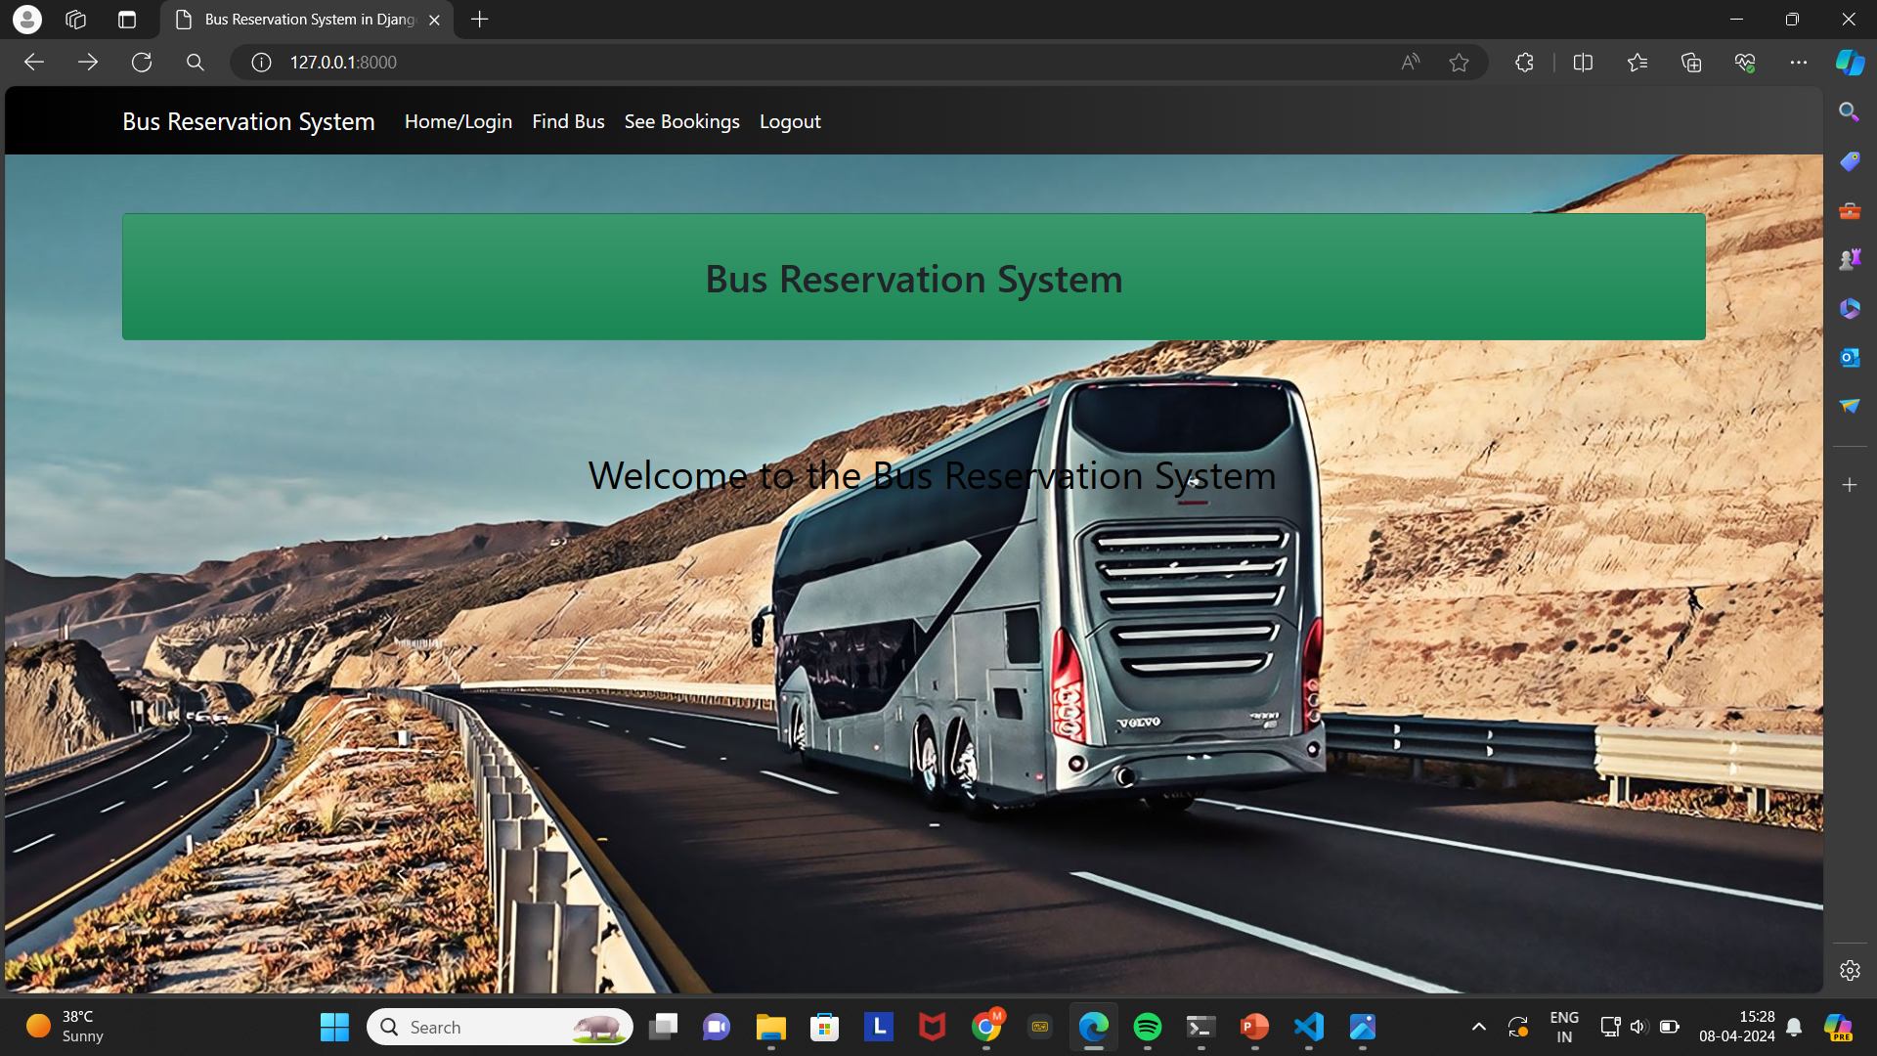
Homepage

Slide 12
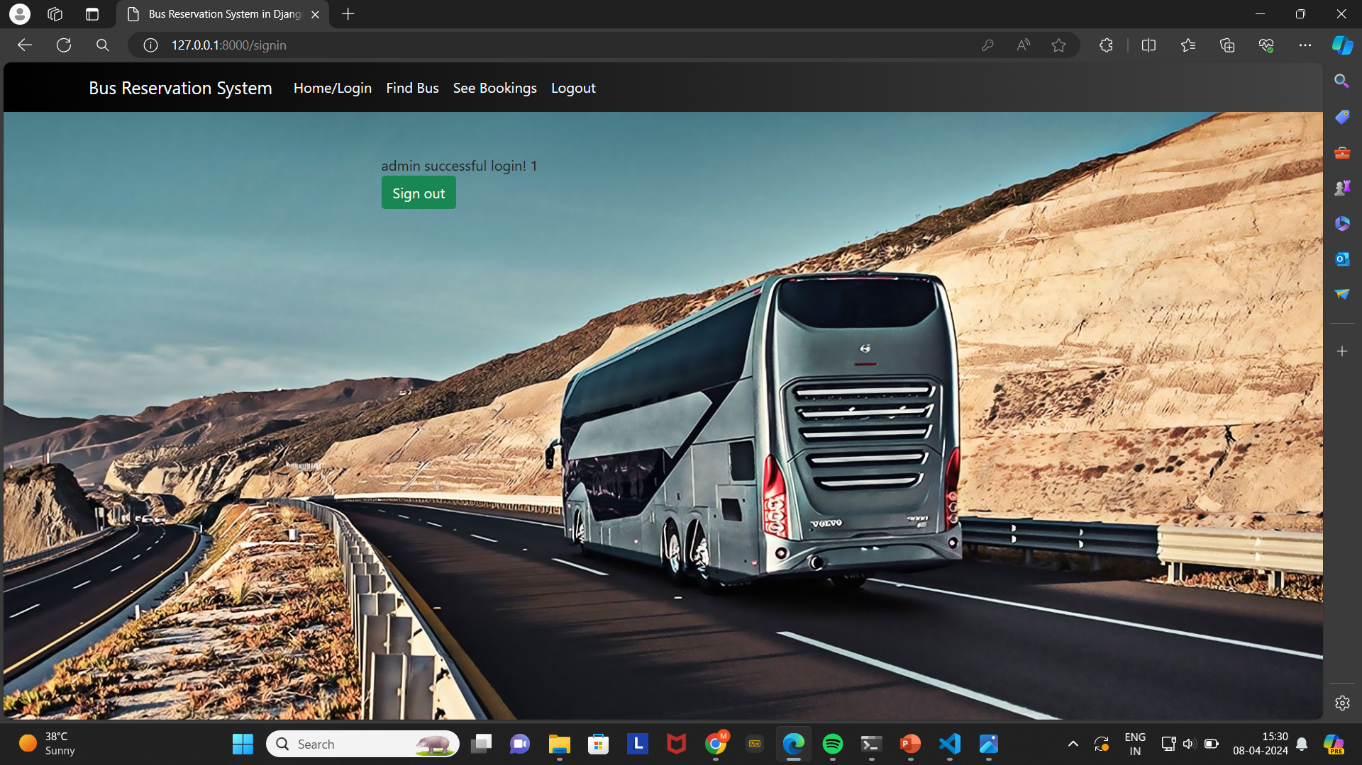
About-Us-Page

Slide 13
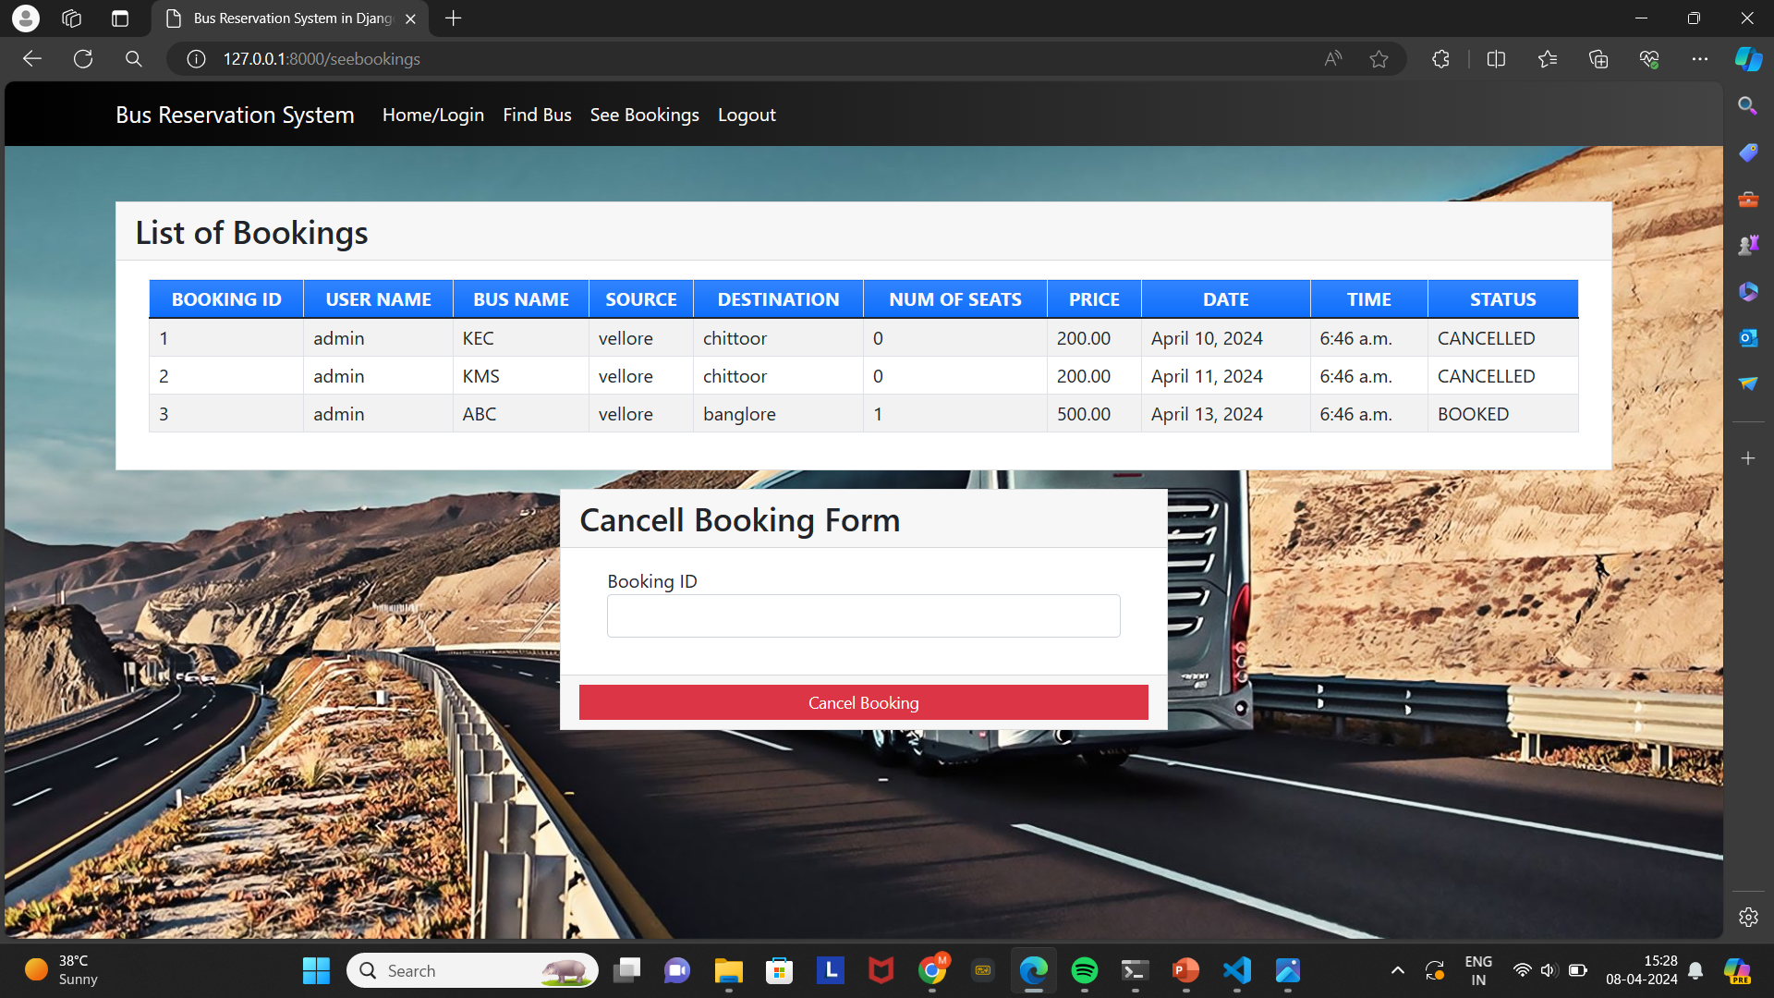
Service-Page

Slide 14
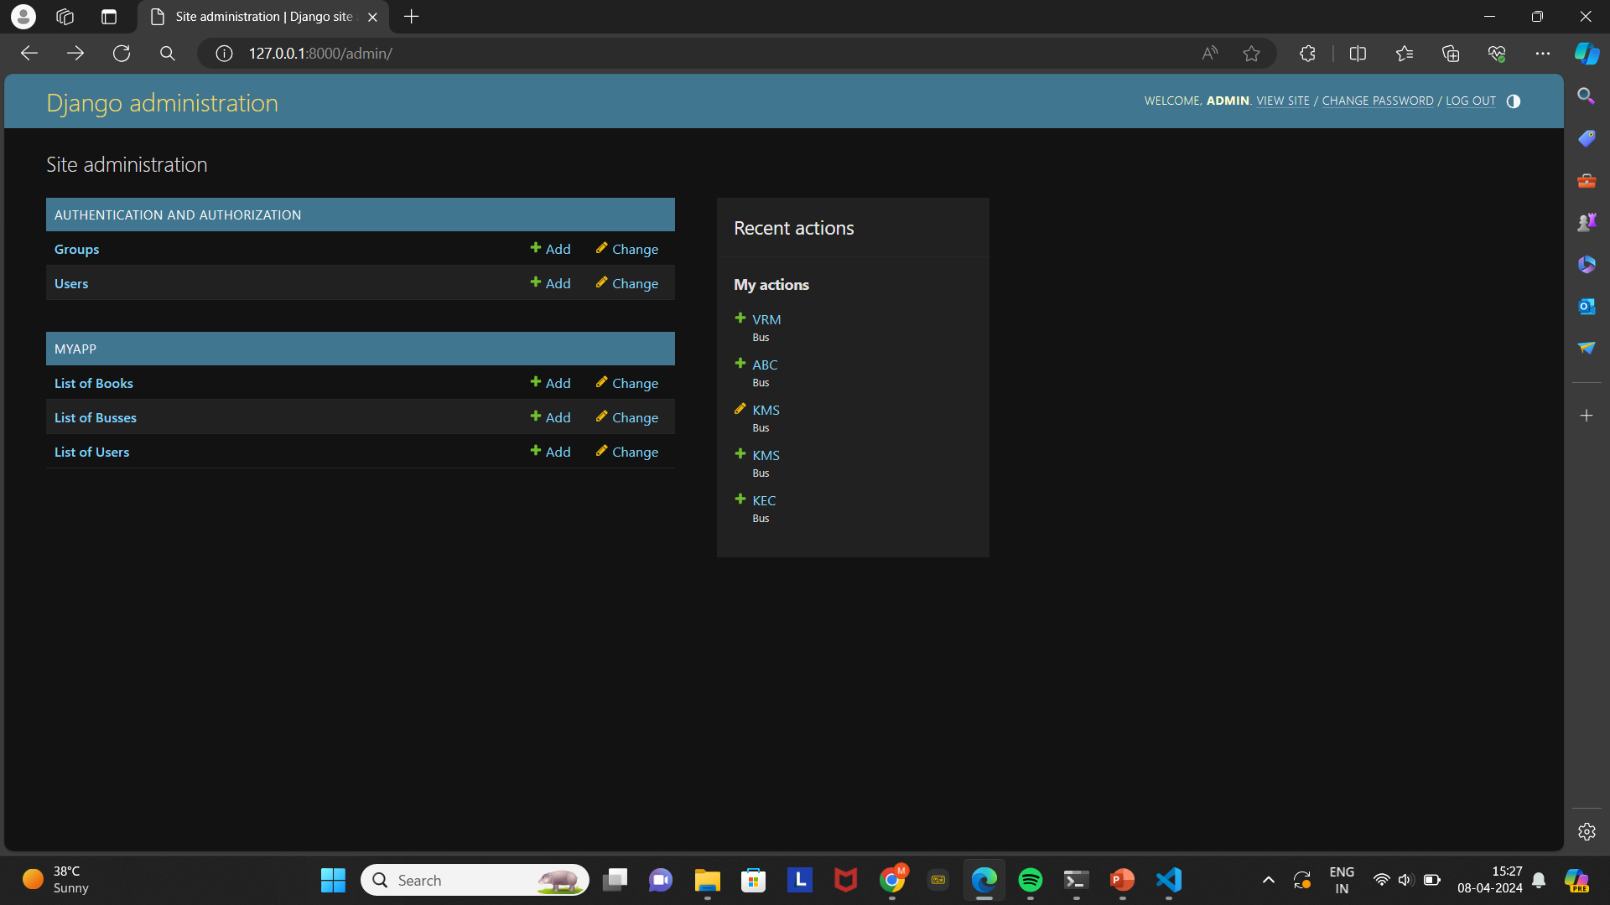
Departments-Page

Slide 15
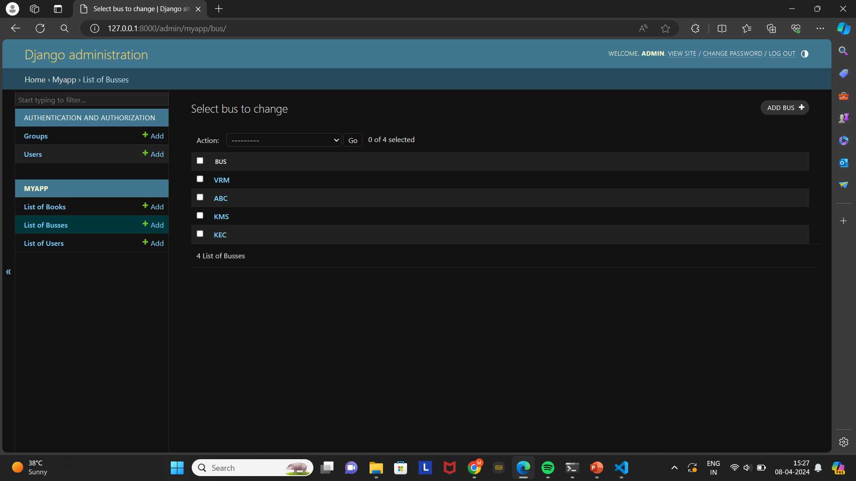
Blog-Page

Slide 16
Future Enhancements:
Future enhancements for the bus reservation system could focus on further improving the user experience, expanding functionality, and enhancing system performance. Some potential areas for enhancement include:
Mobile Application Development: Developing dedicated mobile applications for iOS and Android platforms would provide users with greater convenience and accessibility, allowing them to book and manage bus reservations on the go.
Integration with Payment Gateways: Adding support for additional payment gateways and digital wallets would offer users more flexibility in payment options and streamline the booking process.
Real-time Tracking and Alerts: Implementing real-time bus tracking using GPS technology would enable passengers to track their bus's location and receive alerts for delays, ensuring a more reliable and transparent travel experience.
Personalized Recommendations: Utilizing data analytics and machine learning algorithms to analyze user preferences and booking history could enable the system to provide personalized recommendations for routes, schedules, and promotions tailored to individual users.
Enhanced Security Features: Implementing advanced security measures such as two-factor authentication, encrypted communication channels, and regular security audits would strengthen the system's resilience against cyber threats and protect user data.
Customer Support Integration: Integrating live chat support or chatbots into the system would provide users with immediate assistance and guidance throughout the booking process, improving customer satisfaction and retention.
Social Media Integration: Adding social media integration features would enable users to share their travel experiences, reviews, and recommendations with their social networks, promoting user engagement and brand awareness.
By continuously exploring and implementing these enhancements, the bus reservation system can stay competitive in the market, attract more users, and provide a superior booking experience that meets the evolving needs of passengers.

Slide 17
Conclusion
In conclusion, the bus reservation system presents a comprehensive solution for streamlining and modernizing the process of booking bus tickets. By leveraging technology and best practices, the system offers users a convenient and efficient platform to search for buses, book tickets, and manage their reservations seamlessly.
Through agile development methodologies and collaborative stakeholder engagement, the system was successfully designed, developed, and deployed, meeting the diverse needs and expectations of its users. The system's user-centric approach, coupled with robust features such as real-time tracking, personalized recommendations, and enhanced security, ensures a positive and hassle-free booking experience for passengers.
As the system continues to evolve and incorporate future enhancements, it is poised to remain a leading solution in the transportation industry, providing travelers with reliable and convenient bus travel options. Overall, the bus reservation system represents a significant step forward in modernizing the way people book and manage their bus journeys.
Source :

Slide 18
Thank You!
Notes:
Thank You !!

